Slide 1
Power API on Redfish
HPC EG R&D
Anusha M S
Prasanth Kurian
Vinanti Phadke

Slide 2
Agenda (Modify)
Power API
Sub titles
Redfish
Sub Titles
Redfish Integration
Su Titles
Ganglia

Slide 3
Future of HPC: Exascale computing
At a supercomputing conference in 2009, Computerworld projected Exascale implementation by 2018
Speeds exceeding One exaFLOPS (10¹⁸ FLOPS )
Very large clusters of high performance computational nodes
Different from large commercial datacenters
Primarily scientific in nature
Runs only a few very large jobs at a time sometimes only one job

Slide 4
Design Constraint: Power and Energy aware Applications
Power requirement of tens of megawatt makes it much harder to manage power consumption
Pushing the limits of commercial power delivery
Greatly increasing the cost of facility infrastructure to support
Power and Energy are domain constraints in Exascale computing
Breaching contracts with power utility providers and exceeding on-site physical power limits
Power and Energy based tuning of Jobs and resource reallocations will be essential
Power management functions
to measure
Real time and historical Power and Energy data
and
Effectively Controlling them

Slide 5
Available Solutions and Their Problems
Current Solutions in Market
The Lightweight Distributed Metric Service (LDMS) – collects and aggregates data for variety of hardware
MRNet - collection aggregation over a virtual network
Oscar – compiler and runtime commands
PowerPack toolkit - APIs to enable power measurement on ACPI
Global Energy Optimization Framework (GEO) - manages job power bounds in a cluster and tuning the power consumption
Limitations
Widely varying capabilities and interfaces
Development of supporting tools are costly and inefficient
Lack of single standard API for controlling power and collecting power measurements
Lack of Standard Design hindering customization and new feature support

Slide 6

Addressing the Challenge – Power API
Scope: Developing a standard API
Started in 2014, Sandia Laboratories in collaboration with other Labs and major vendors including Intel, IBM, AMD, Cray, Hewlett Packard Enterprise, Adaptive computing and Penguin computing
To develop a power API for high-performance computing systems
An interface for standardizing power and energy measurement and control for large-scale and eventually EXAscale systems, which are expected to emerge in the 2020–2024 timeframe.
Which is also suitable for smaller-scale systems, from commercial datacenters to individual desktops
Power API

Slide 7
Key Features
Power API provides a common, cross-vendor interface to measure and Control the power use of hardware
API function calls, with interfaces for applications to measure and react to their own execution
Rich statistics-gathering interface that manage and control scaling from
Whole cluster
Multiple nodes
A single system
To individual component-level measurements to Sockets, Cores, DIMMs etc.

Slide 8
Key Features continued
Scripting interfaces for system administrators to quickly enact custom power control.
Both real-time (active measurements) and historical (database logging) contexts.
High-frequency measurement
Supports multiple power monitoring devices at the backend and transparently to the end user
Flexibility considering future system architectures and power measurement and control capabilities
Freedom in defining system architectures
Highly customizable without breaking the Standard Interface

Slide 9
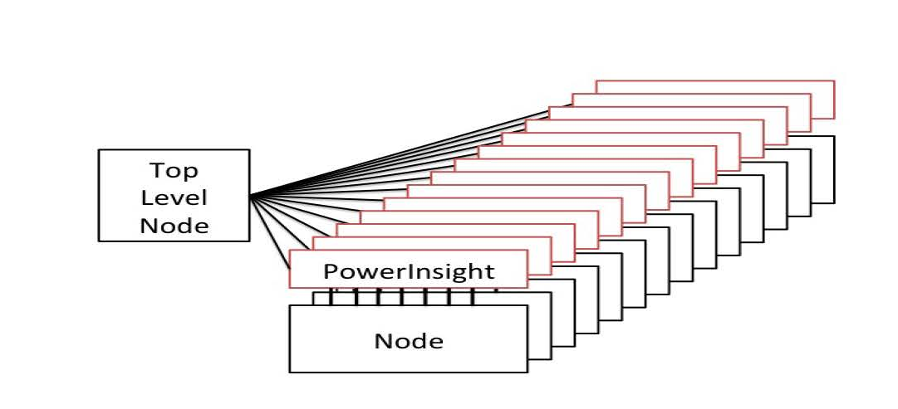
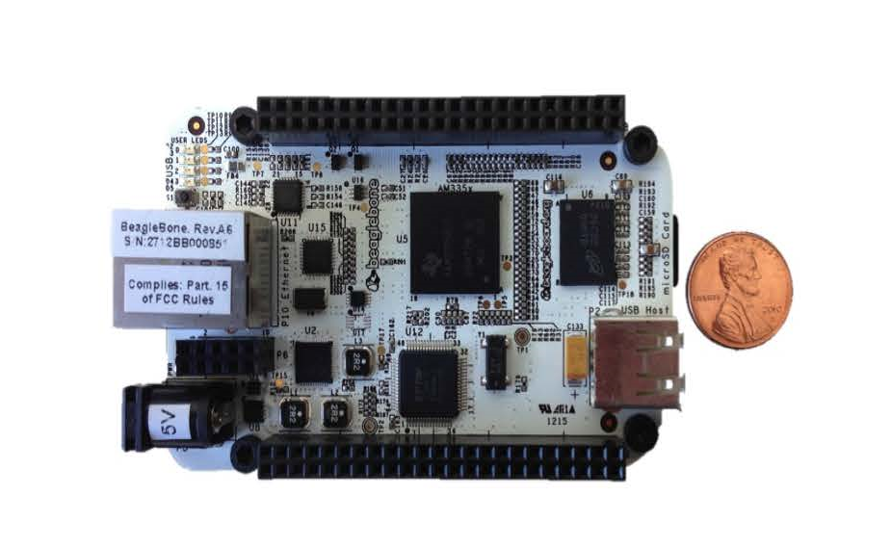
Some of the Supported Devices
In-band
Intel’s running average power limit (RAPL) controls and
AMD’s TDP Power Cap
Out-Of-Band
Penguin Computing’s PowerInsight
RNet’s WattProf
RENCI’s PowerMon
PowerInsight

Slide 10
API Key Design Thoughts
Hierarchical Description
User Roles
Distributed architecture

Slide 11
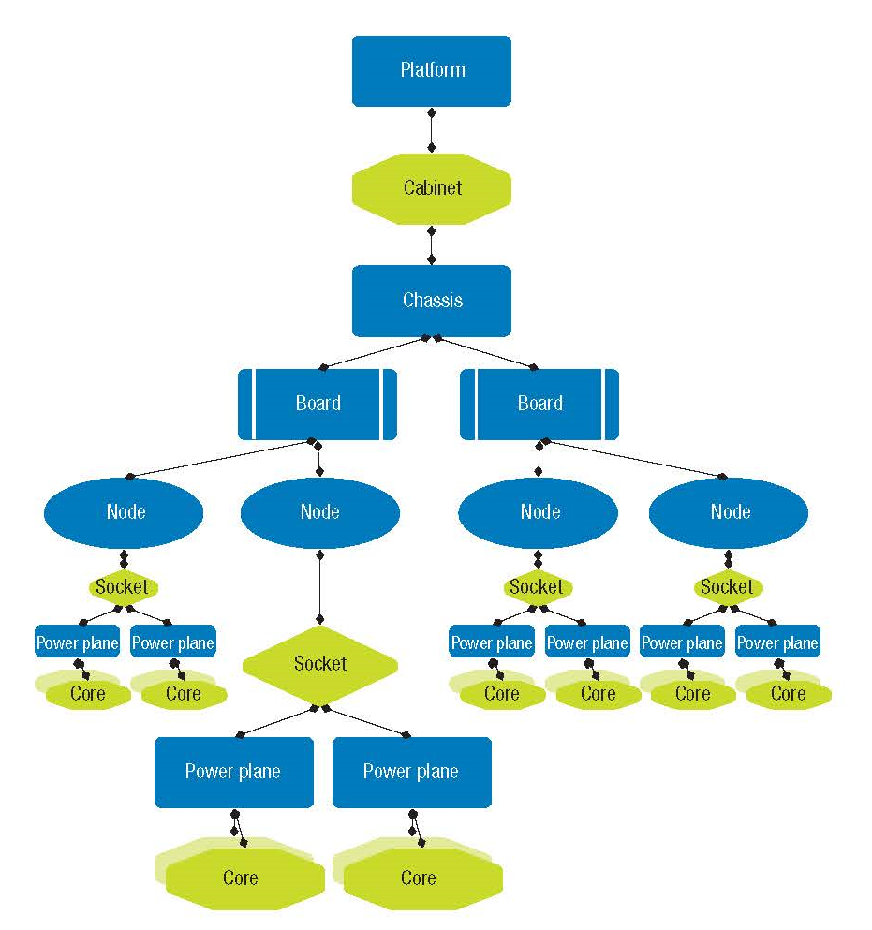
Hierarchical Description
can insert additional objects as needed, including memories, network interfaces, accelerators.
power measurements or controls can be aggregated

Slide 12
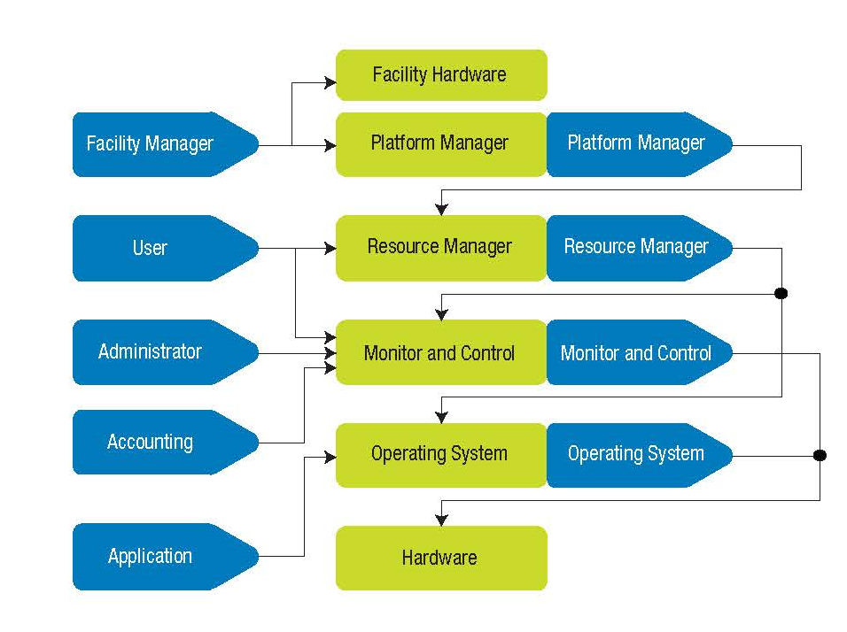
User Roles
Platform Manager
Reflects the responsibility of dictating overall system-level policies, such as scheduling priorities and facility limitations
User role
Provides all the capabilities potentially exposed to end users like measurement and controlling.
Application role
Interface for user applications.It is similar to the User role, But with the ability to describe lower-level requirements.
Administrator role
Represents the traditional IT system administrator function, managing day-to-day system operation, but from a powerand energy perspective
Accounting role
Interface for generating reports and system metrics at different levels of granularity, from system to individual component
Resource Manager role
Is oriented toward resource managers and job schedulers

Slide 13
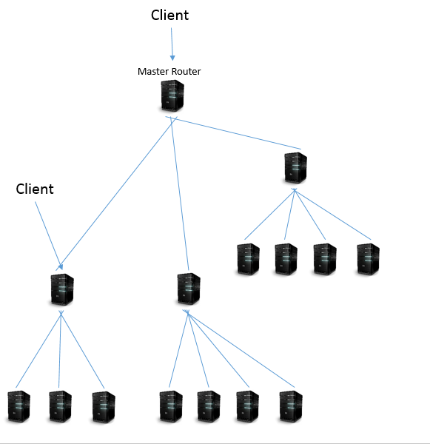
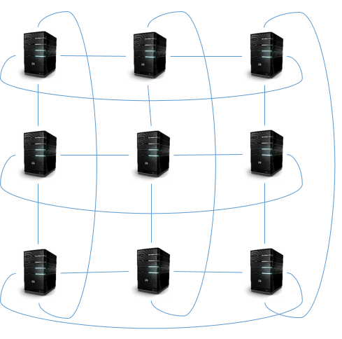
Routing in Distributed Environment
Tree
Torus

Slide 14
Demo

Slide 15

What is Redfish?
A DMTF (Distributed Management Task Force) Standard.
For managing multi-node servers via a RESTful interface.
A secure replacement for IPMI-over-LAN
Usable by client applications and browser-based GUIs .
Built on a modern tool-chain (HTTPS, JSON, OData) .
Earlier it was targeted towards servers management but now its been extended to other devices as well.

Slide 16
Why Redfish?
The industry doesn't want to learn a tool chain to perform basic management tasks on a platform.
Leverages existing Internet standards and tool chains
Usable by pros and amateurs.
Schema-backed but human-readable
Can interact with multiple objects and attributes in parallel
Deployable on existing management controllers.
Provides Out of band management

Slide 17
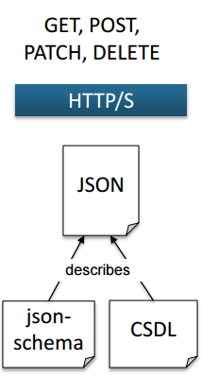
Why REST , HTTPS and JSON?
RESTful API architectures are rapidly replacing SOAP (web services)
HTTP/HTTPS protocol is well understood by admin and has well known security Model and Network Configuration.
JSON is a modern data format which is human-readable and simpler than XML and has Modern Language Support
The combination of language support and ubiquity of REST, HTTPS and JSON means that systems management tasks can be performed using the same skill set and tool chain as all other IT and dev/ops tasks.

Slide 18
Redfish Resource Map
/redfish/v1
Root resource Links to all content
/redfish/v1/Systems
/redfish/v1/Systems/<id>
Collection of systems
Server information
Model no, serial no, Boot order, NIC MAC, status etc
Processors
/redfish/v1/Chassis
Disks
Collection of chassis
/redfish/v1/Chassis/<id>
NICs
Chassis Chassis global physical asset info
Power
Thermal

Slide 19
How simple is Rest Using JSON?
Example python code to get temperature of chassis from a server
Output is

Slide 20
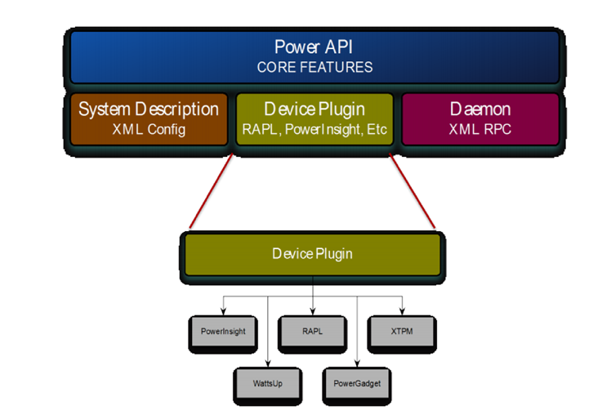
Reference Implementation

Slide 21

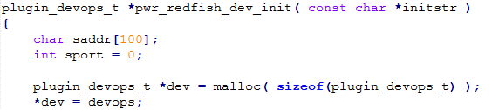
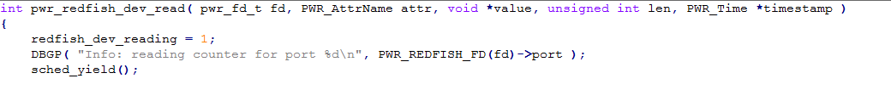
Power API over Redfish – Schematic Workflow
Power API
Initialization
Initialize a connection with agent
Create a session
Redfish Agents
Written in python
Light weight daemons listening over TCP/IP port 20220
Receives the node, device and attributes information from the plugin
Converts received information into REST Uniform Resource Identifiers (URIs) Eg. /redfish/v1/Chassis
Can talk to a local machine via hprest Channel Interface Driver (In-band)
Can Talk to remote machine securely over HTTPS (Out-of-band)
Power API
Power management over an exascale systems
Can talk to redfish plugins
Open
Sends node and device information to the agent in the format <node name>.<device name> Eg. node0.cpu1
Close and finalize
Cleanup and Closes the session
Redfish Plugin
Plugins provide common POSIX-like abstraction to underlying resource capabilities which include devices, system mechanisms.
Redfish plugin can talk to underlying redfish compliant systems via Redfish agents
Can talk to multiple agents
Read
Sends the attributes like Voltage, Power, Temperature to the agent to read from the ILO for the corresponding device
Initialization
open
Read
Redfish Agent
Close & Finalize
Worker Thread1
Open new session
Redfish Plugin
node0.cpu1
Queue
R3 | R2 | R1
Worker Thread2
Get the Maximum Frequency
Close the session
Worker Thread3

Slide 22
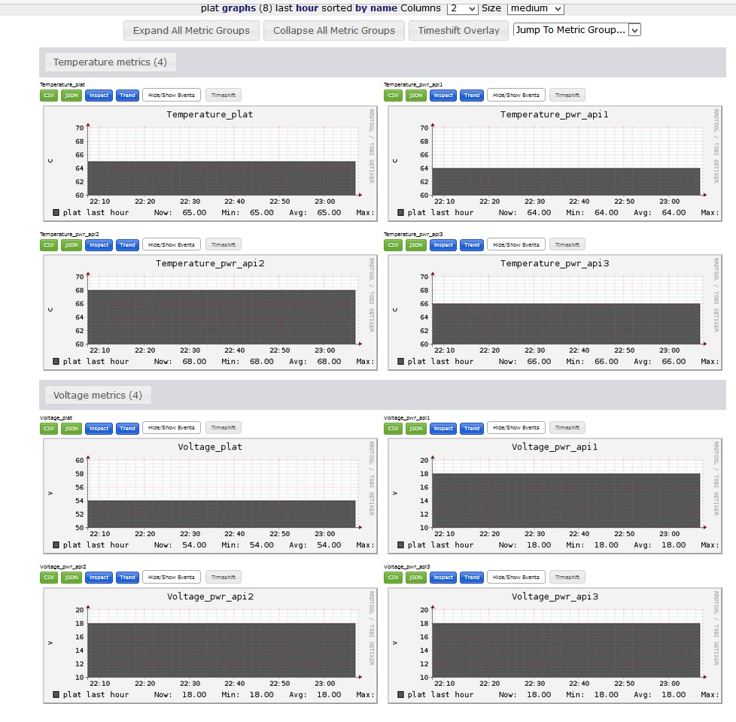
Ganglia Integration

Slide 23
Thank you

Slide 24
Key Features
Diverse requirements, from application-level fine-grained control and measurement to facility-level accounting For managing multi-node servers
High-frequency measurement
Rich statistics-gathering interface that scales from individual component-level measurements up to and including whole-system statistics
In both real-time (active measurements) and historical (database logging) contexts.

Slide 25
PWR_ATTR_PSTATE /* uint64_t */
PWR_ATTR_CSTATE, /* uint64_t */
PWR_ATTR_CSTATE_LIMIT, /* uint64_t */
PWR_ATTR_SSTATE, /* uint64_t */
PWR_ATTR_CURRENT, /* double, amps */
PWR_ATTR_VOLTAGE, /* double, volts */
PWR_ATTR_POWER, /* double, watts */
PWR_ATTR_POWER_LIMIT_MIN, /* double, watts */
PWR_ATTR_POWER_LIMIT_MAX, /* double, watts */
PWR_ATTR_FREQ, /* double, Hz */
PWR_ATTR_FREQ_LIMIT_MIN, /* double, Hz */
PWR_ATTR_FREQ_LIMIT_MAX, /* double, Hz */
PWR_ATTR_ENERGY, /* double, joules */
PWR_ATTR_TEMP, /* double, degrees Celsius */
PWR_ATTR_OS_ID, /* uint64_t */
PWR_ATTR_THROTTLED_TIME, /* uint64_t */
PWR_ATTR_THROTTLED_COUNT, /* uint64_t */
PWR_ATTR_GOV, /* uint64_t */
PWR_NUM_ATTR_NAMES, /* */
PWR_ATTR_INVALID =
PWR_ATTR_NOT_SPECIFIED

